Slide 1
Create a secure workplace for the hybrid world with Cloud PC
Ola Ström

Slide 2
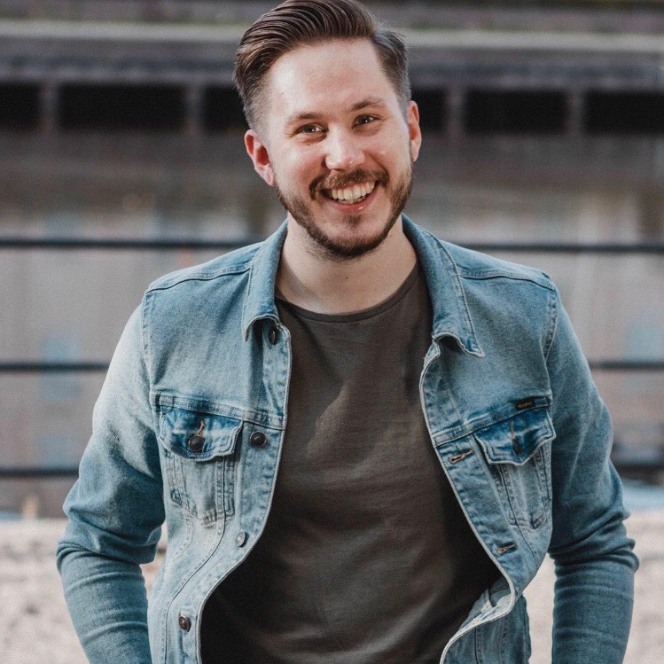
Ola Ström
Based Sweden
Dog dad 🐶
Golfer 🏌️
Chief Technical Architect – Devices @ Advania Knowledge Factory
Microsoft MVP – Windows and Devices for IT 💻☁️
10+ years with Microsoft Intune

Slide 3

Agenda
Intro
Setting the scene…
Demo
Q&A

Slide 4

Background
More hybrid workers
External and internal personal
Increased need for security
Inspire to real world use cases
Work in progress…

Slide 5
Setting the scene…

Slide 6

Create a setup where:
Teams can be used, BUT sensitive material cannot be accessed if not using a managed device
Add layers of security to the Cloud PC
Allow access to the Cloud PC externally
Make use of features in the Microsoft suite
A little bit utopia

Slide 7

DISCLAIMER
Shortcuts will be taken!

Slide 8
DEMO!!!!!

Slide 9

Q&A

Slide 10




Thank you
Ola Ström
Advania - Knowledge Factory
Twitter: @olastromcom
Blog: https://www.olastrom.com

Slide 11
Resources
Sensitivity labels in Microsoft Teams | AgrenPoint Blog
Security Guidelines For Cloud PCs - techlab.blog
Teamsdagen 2022: Säkert och produktivt samarbete i en hybrid värld -coolt! (Simon Ågren & Ola Ström) - YouTube

